Slide 1
Code Generation based on - Dynamic Programming - Tree rewriting

Slide 2
Dynamic programming
Compute bottom-up for each node n of the expression tree T an array C of costs, in which the ith component C[i] is the optimal cost of computing the subtree S rooted at n into a register, assuming i registers are available for the computation
Traverse T, using the cost vectors to determine which sub-trees of T must be computed into memory.

Slide 3
Dynamic programming
Traverse each tree using the cost vectors and associated instructions to generate the final target code. The code for the sub-trees computed into memory locations is generated first.

Slide 4
Assumption
Only two registers are available
Instructions
Ri := Mj
Ri := Ri op Rj
Ri := Ri op Mj
Ri := Rj
Mi := Ri

Slide 5
Assumption
Cost of computing a node which is in memory involves 0

Slide 6
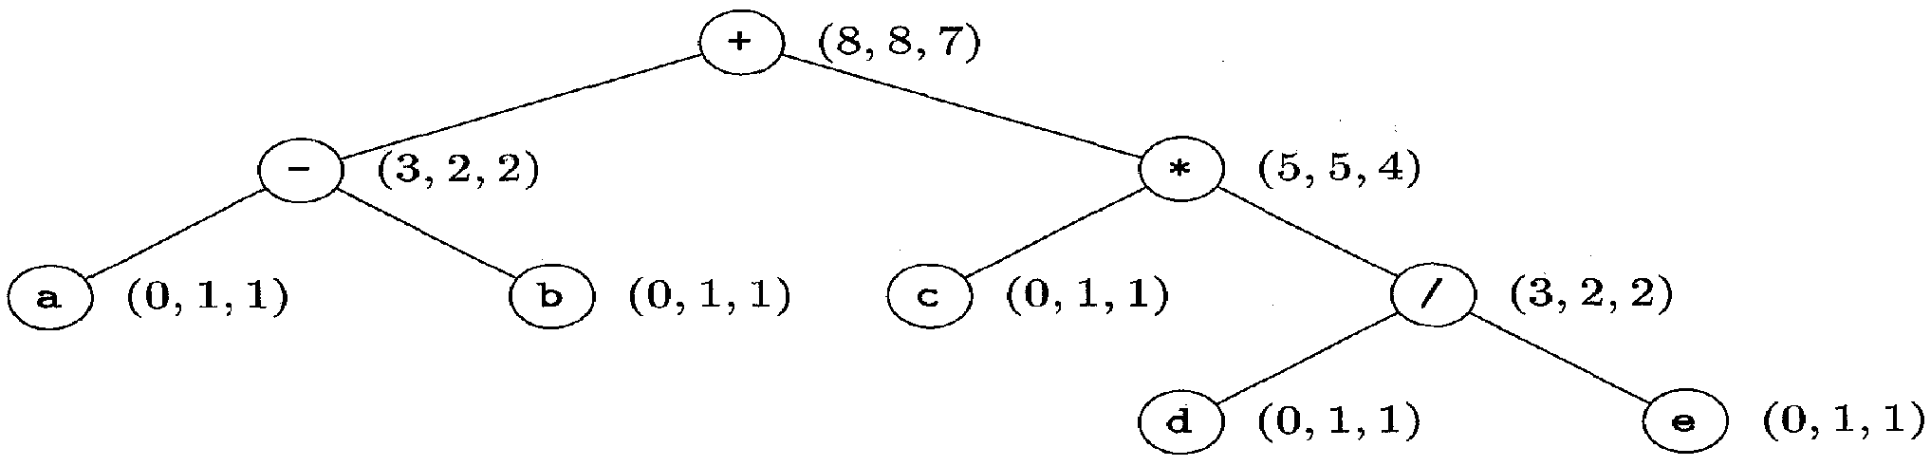
Syntax tree for (a-b)+c*(d/e) with cost vector at each node

Slide 7
Computation
Leaf nodes
Cost of moving a variable with no registers is 0
Cost of moving a variable with 1/ 2 registers is 1 using the instruction Ri : = Mj
Cost of leaf nodes are just (0, 1, 1) using no register, 1 register, 2 registers

Slide 8
Computation
Last but one node – find all possible and choose the least cost
Computing this using no registers,
Ri := Mj (costs 1)
Ri := Ri op Mj (costs 1) Total cost = 3
Mj : = Ri (costs 1)
(or)
Ri := Mj (costs 1)
Rj := Mi (costs 1)}
Ri := Ri op Rj (costs 1) Total cost = 4
Mj : = Ri (costs 1)

Slide 9
Computation
Last but one node – find all possible and choose the least cost
Computing this using one register
Ri := Mj (costs 1)
Ri := Ri op Mj (costs 1) Total cost = 2
(or)
Ri := Mj (costs 1)
Rj := Mi (costs 1) Total cost = 4
Ri := Ri op Rj (costs 1)
Mj : = Ri (costs 1)

Slide 10
Computation
Cost vector of the last but one level node
(3, 2, 2)

Slide 11
Computation
Last but one node – find all possible and choose the least cost
Computing this using two registers
Ri := Mj (costs 1)
Ri := Ri op Mj (costs 1) Total cost = 2
(or)
Ri := Mj (costs 1)
Rj := Mi (costs 1)} Total cost = 3
Ri := Ri op Rj (costs 1)

Slide 12
Minimum Cost
Compute the left subtree with two registers available into register R0, compute the right subtree with one register available into register R1, and use the instruction ADD R0, R0, R1 to compute the root. This sequence has cost 2+5+1=8.

Slide 13
Minimum Cost
Compute the right subtree with two registers available into R l , compute the left subtree with one register available into R0, and use the instruction ADD R0, R0, R1. This sequence has cost 4+2+1=7.
Compute the right subtree into memory location M, compute the left subtree with two registers available into register RO, and use the instruction ADD R0, R0, M. This sequence has cost 5+2+1=8

Slide 14
Code
R0 := c LD R0, c
R1 := d LD R1, d
R1 := R1/e DIV R1, R1, e
R0 := R0 * R1 MUL R0, R0, R1
R1 := a LD R1, a
R1 := R1 – b SUB R1, R1, b
R1:= R1 + R0 ADD R1, R1, R0

Slide 15
Code-Generator generators
Picking an evaluation order
Assigning registers
Selecting appropriate target-language instructions

Slide 16
Code-generation by tree rewriting
Assume that the evaluation order and registers are done then the intermediate language could be converted to a representation as a tree.
The tree should correspond to one of the pre-defined template tree
After matching with the template, there is a predefined code for every tree and is generated

Slide 17
Code-generator generators
Pre-defined Template and their code
3 address code
One of the template tree
Intermediate code to Template tree conversion
Assembly code
Code generation

Slide 18
Target code
Input tree is reduced into a single node by applying a sequence of tree-rewriting rules
Tree re-writing rules – Translation scheme
Replacement ← template {action}
Replacement – single node
Template – tree
Action – code fragment

Slide 19
Tree rewriting rules
Rule Number | Rule | Target code
(1) | reg_{i} ← const_{c} | {MOV #c, R_{i} }
(2) | reg_{i} ← mem_{a} | {MOV a, R_{i} }
(3) | mem ← := mem_{a} reg_{i} | {MOV R_{i} , a}
(4) | mem ← := ind reg_{i} reg_{j} | {MOV R_{j} , *R_{i} }

Slide 20
Tree rewriting rules
Rule Number | Rule | Target code
(5) | reg_{i} ← ind + const_{c} reg_{i} | {MOV c(R_{j} ) , R_{i} }
(6) | reg_{i} ← + reg_{i} reg_{j} | {ADD R_{j} , R_{i} }

Slide 21
Tree rewriting rules
Rule Number | Rule | Target code
(7) | reg_{i} ← + reg_{i} ind + const_{c} reg_{i} | {ADD c(R_{j} ) , R_{i} }
(8) | reg_{i} ← + reg_{i} const₁ | {INC R_{i} }

Slide 22
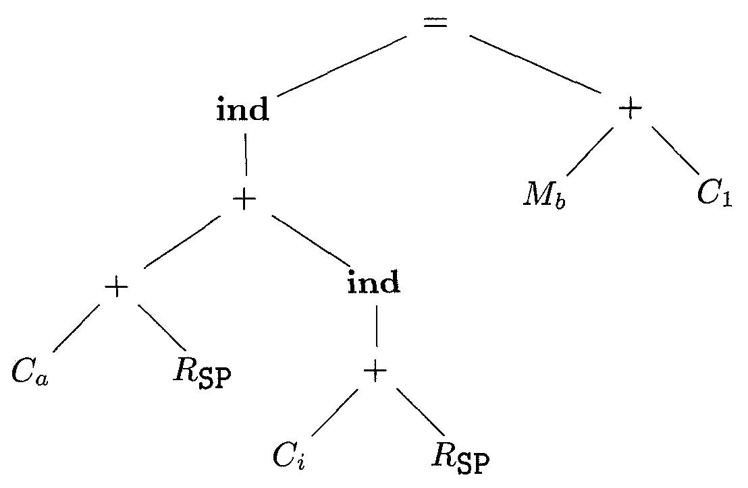
Intermediate code tree a[i] := b+1

Slide 23
Final code
Apply rule 1: MOV #a, R0
Apply rule 6: ADD SP, R0
Apply rule 7: ADD i(SP), R0
Apply rule 2: MOV b, R1
Apply rule 8: INC R1
Apply rule 4: MOV R1, *R0

Slide 24
SDT for scheme construction
reg_{i} 🡪 const_{c} {MOV #c, R_{i} }
reg_{i} 🡪 mem_{a} {MOV a, R_{i} }
mem 🡪 := mem _{a} reg_{i} {MOV R_{i} , a}
mem 🡪 := ind reg_{i} reg_{j} {MOV R_{j} , *R_{i} }
reg_{i} 🡪 ind + const_{c} reg_{j} {MOV c(R_{j} ), R_{i} }
reg_{i} 🡪 + reg_{i} ind + const_{c} reg_{j}
{ADD c(R_{j} ), R_{i} }

Slide 25
SDT for scheme construction
reg_{i} 🡪 + reg_{i} reg_{j} {ADD R_{j} , R_{i} }
reg_{i} 🡪 + reg_{i} const₁ {INC R_{i} }

